Slide 1
Big Mountain Resort Case Study

Slide 2
Problem Identification
Recommend strategy to Big Mountain resort for keeping the profit margins at 9.2% and give an insight on annual revenue for the season
Context
Big Mountain resort has spent $1.54MM for installation of a new chair list system in order to maintain the visitors more efficiently. The management is looking for recommendations to increase revenues to recoup the operational investment while keeping the annual profit margins of 9.2%.

Slide 3
Problem Scope
In order to account for the problem statement above we looked at the variables which can directly lead to increased revenue generation i.e. the tickets prices and the number of days resort is predicted to be open this season.
Data from various resorts wit number of characteristics were studied and analyzed keeping the ticket prices and number of days the resort would be open as target variables i.e. the values we will predict.

Slide 4
Data Wrangling
Data Cleaning
Data Cleansing by assigning correct data types to each column
Removal of null values from numerical columns
Exploratory Data Analysis
Pair plots between numerical features to study the relationships between multiple variables
Column charts for State and Region to see distribution of various resorts
Removal of certain columns which show similar behavior
Outlier detection based on IQR and removal of outliers

Slide 5
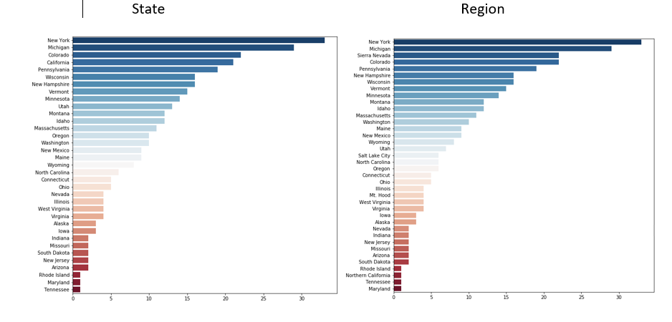
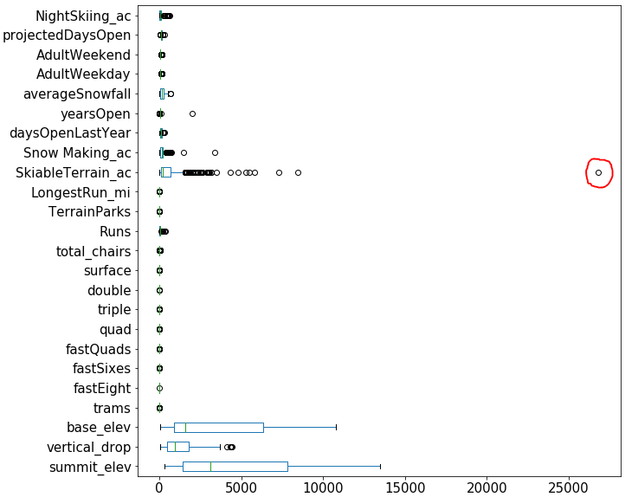
Data Wrangling

Slide 6
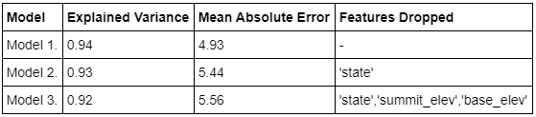
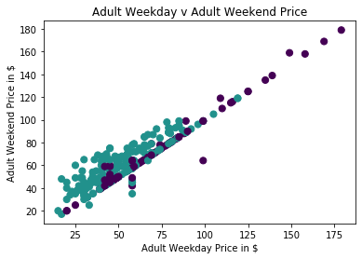
Modeling
Linear regression is used as the model for predicting revised prices.
Below is the model evaluation for metrics MAE and Explained Variance (RSME)
Model 1 is chosen as it has the highest Explained Variance and lowest MAE.
Since ticket prices for Adults during weekends and weekdays are highly correlated hence in this case the recommendations can be used for both

Slide 7
Recommendations
Prices for Adult Weekend tickets to be revised to $89.2 which is 10.2% increase
Likewise, since the prices for tickets in weekdays and weekends are highly correlated hence the prices for Adult tickets on weekdays should also be increased by 10.2%
The projected number of days when the resort should be open to be increased to 143 days which should result in 20% increase of visitors

Slide 8
Conclusion
Increase in number of days the resort open will increase visitors by 20% i.e. approximately 417,000 with an assumed distribution of adults being 60%.
Increased tickets prices of $89 will be applicable to 60% of total visitors.
Projections based on recommendations
Revenue $2.0 MM
Operational Cost in new chair ~ 1.5 MM
Profit ~500K

